Slide 1
CLIMA

Slide 2
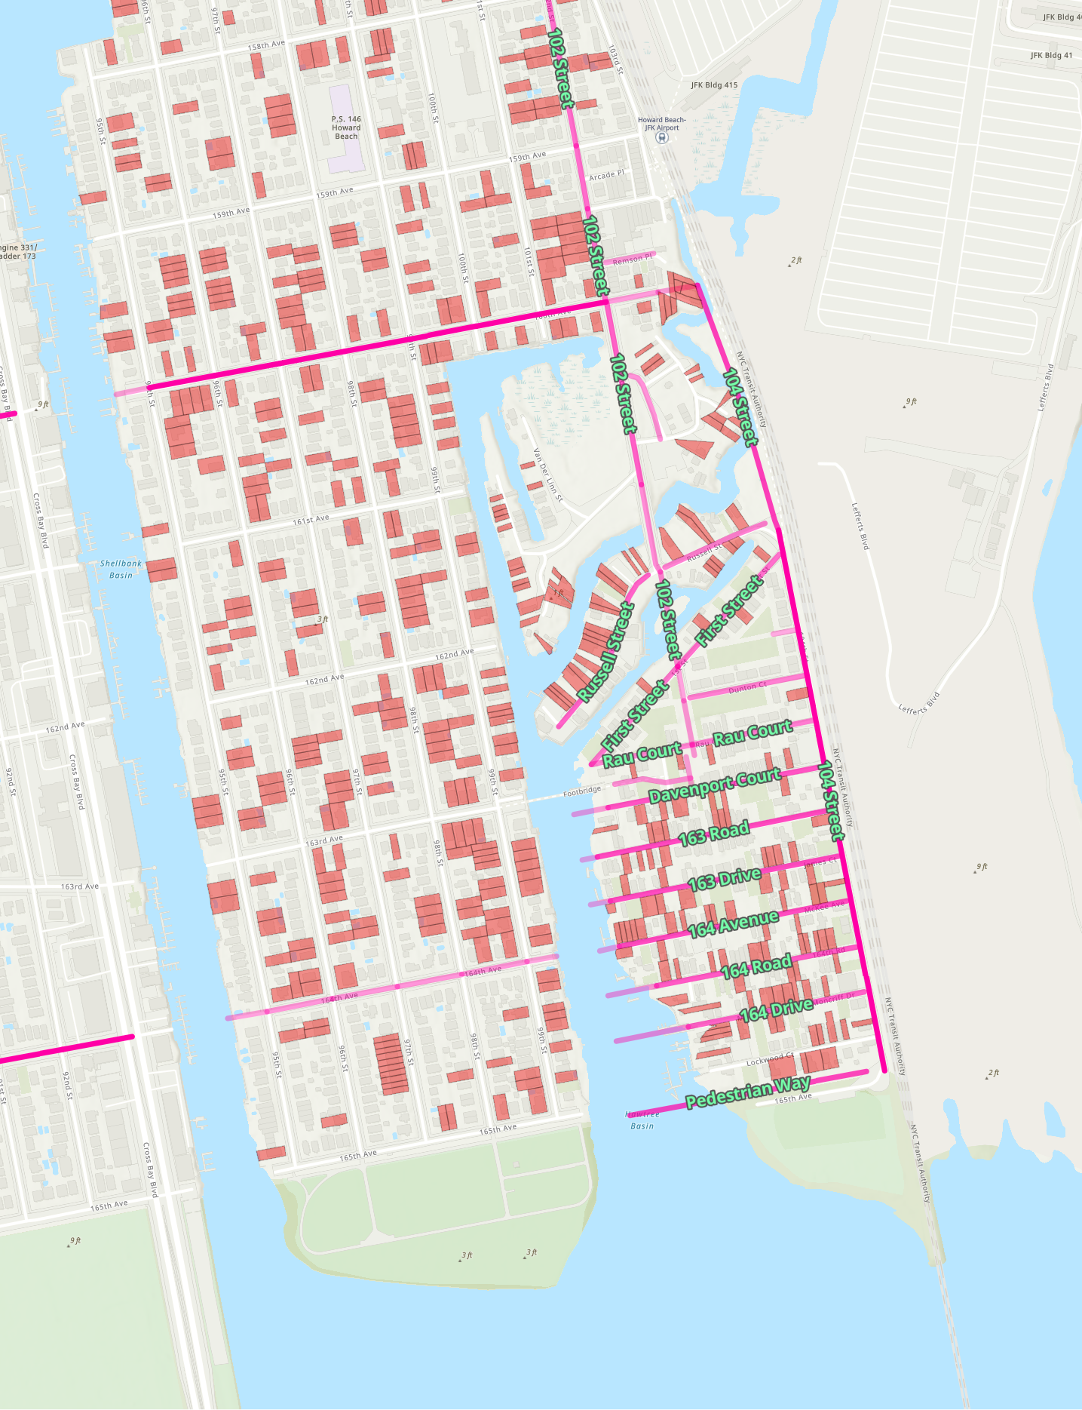
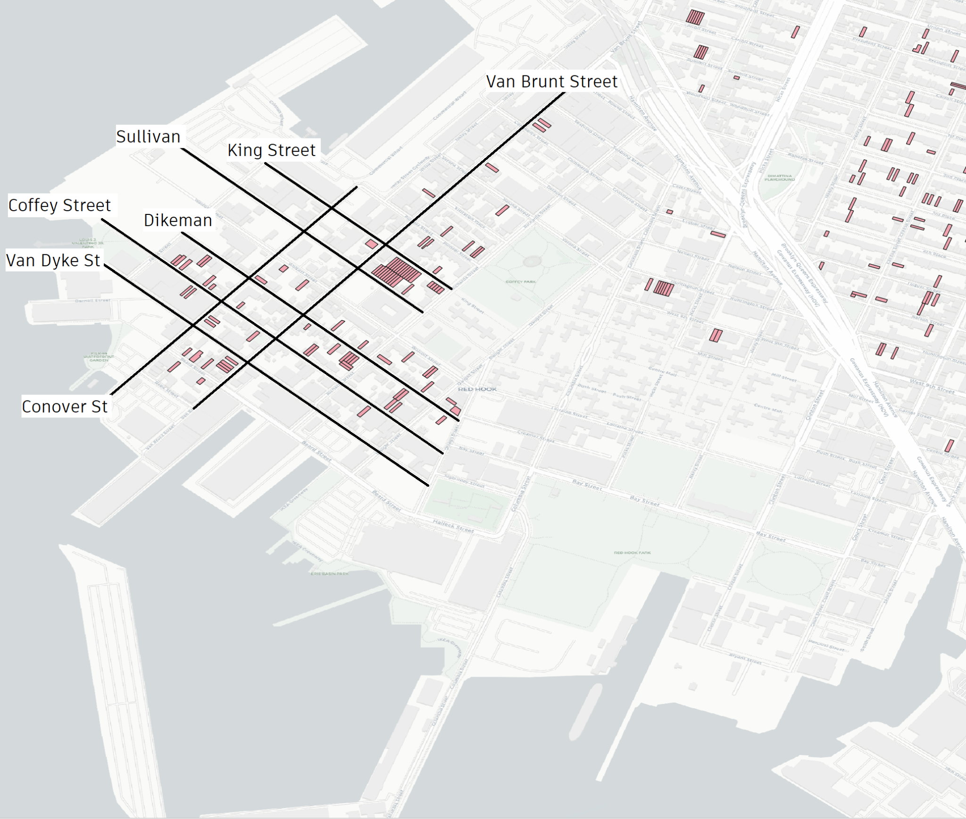
Locations:

Slide 3
SLIDE WITH SMALL TITLE
GEOID Type: | GEOIDS Included: | Network Type: | y | Linear Fit: | Confidence Interval: | Adj. R^2: | Averages:
County | 3141 | Total | Rescaled Cumulative Total Degree | y = 0.972x + 0.019 | Exp: [0.967, 0.977] Intercept: [0.015,0.024] | 0.979 | Rescaled Degree: 115,046,176 (Pop; Users): 106,879; 54,429
 |  | Inner | Rescaled Cumulative Inner-Total Degree | y = 1.062x - 0.013 | Exp: [1.052, 1.073] Intercept: [-0.022, -0.004] | 0.925 | Rescaled Degree: 35,816,319 (Pop; Users): 106,879; 54,429
 |  | Outgoing | Rescaled Cumulative Outgoing-Total Degree | y = 0.945x + 0.024 | Exp: [0.939, 0.950] Intercept: [0.020, 0.029] | 0.975 | Rescaled Degree: 79,229,857 (Pop; Users): 106,879; 54,429
CBSA | 917 | Total | Rescaled Cumulative Total Degree | y = 0.979x + 0.009 | Exp: [0.967, 0.990] Intercept: [0.000, 0.017] | 0.969 | Rescaled Degree: 369,646,071 (Pop; Users): 345,975;175,799
 |  | Inner | Rescaled Cumu. Inner-Total Degree | y = 1.064x - 0.065 | Exp: [1.046, 1.082] Intercept: [-0.079, -0.051] | 0.937 | Rescaled Degree: 166,674,627 (Pop; Users): 345,975;175,799
 |  | Outgoing | Rescaled Cumu. Outgoing-Total Degree | y = 0.924x + 0.047 | Exp: [0.913, 0.936] Intercept: [0.039, 0.056] | 0.966 | Rescaled Degree: 202,971,443 (Pop; Users): 345,975;175,799
MSA | 381 | Total | Rescaled Cumulative Total Degree | y = 0.982x + 0.006 | Exp: [0.962, 1.002] Intercept: [-0.006, 0.017] | 0.962 | Rescaled Degree: 806,430,257 (Pop; Users): 760,791;385,411
 |  | Inner | Rescaled Cumulative Inner-Total Degree | y = 1.082x - 0.048 | Exp: [1.049, 1.114] Intercept: [-0.067, -0.028] | 0.919 | Rescaled Degree: 372,823,802 (Pop; Users): 760,791;385,411
 |  | Outgoing | Rescaled Cumulative Outgoing-Total Degree | y = 0.914x + 0.033 | Exp: [0.894, 0.933] Intercept: [0.021, 0.045] | 0.958 | Rescaled Degree: 433,696,455 (Pop; Users): 760,791;385,411
muSA | 536 | Total | Rescaled Cumulative Total Degree | y = 0.969x - 0.009 | Exp: [0.931, 1.007] Intercept: [-0.018, 0.000] | 0.821 | Rescaled Degree: 59,170,744 (Pop; Users): 51,115; 26,802
 |  | Inner | Rescaled Cumulative Inner-Total Degree | y = 1.054x - 0.029 | Exp: [0.994, 1.113] Intercept: [-0.042, -0.016] | 0.694 | Rescaled Degree: 20,139,486 (Pop; Users): 51,115; 26,802
 |  | Outgoing | Rescaled Cumulative Outgoing-Total Degree | y = 0.921x - 0.007 | Exp: [0.883, 0.960] Intercept: [-0.016, 0.002] | 0.805 | Rescaled Degree: 39,031,258 (Pop; Users): 51,115; 26,802
Since its founding in 1831, NYU has been an innovator in higher education, reaching out to an emerging middle class, embracing an urban identity and professional focus, and promoting a global vision that informs its 19 schools and colleges.

Slide 4
Social Connectedness Index Plots
Histograms

Slide 5
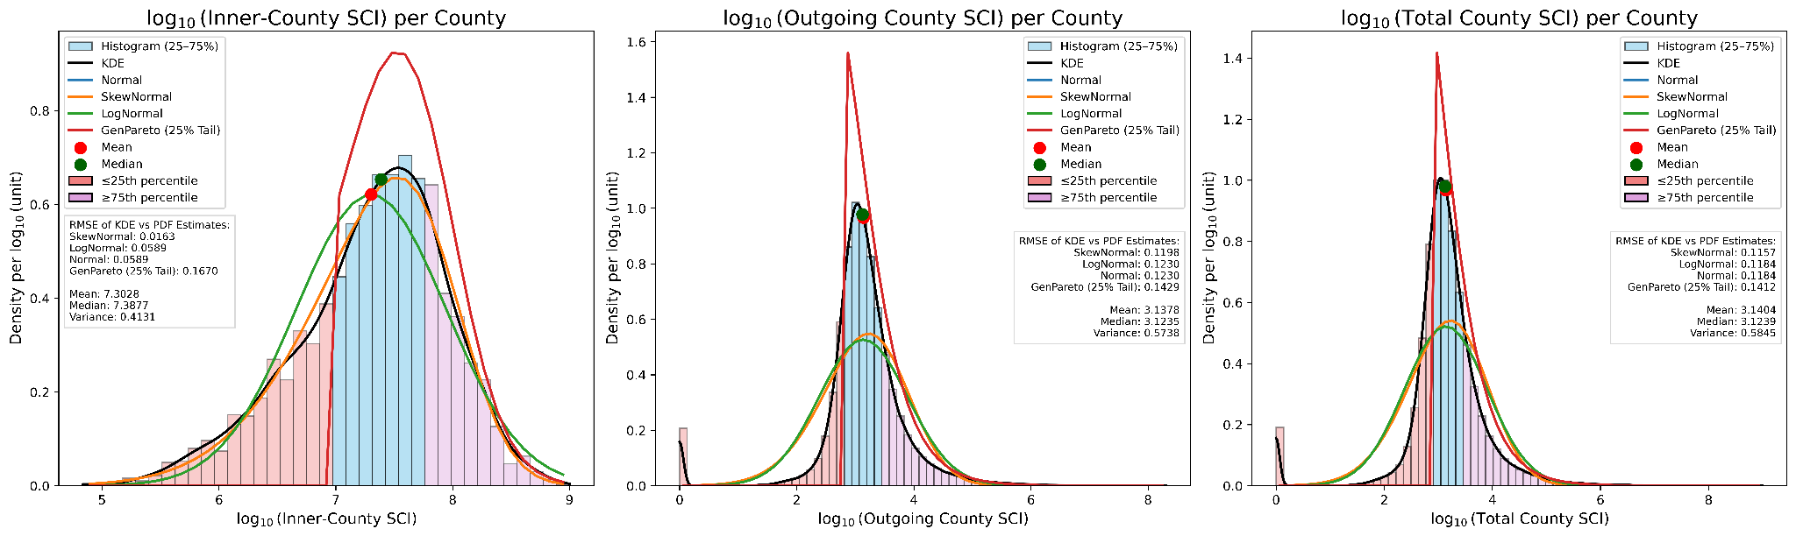

Slide 6
County
Plots
Regressions
Histograms
Choropleths

Slide 7
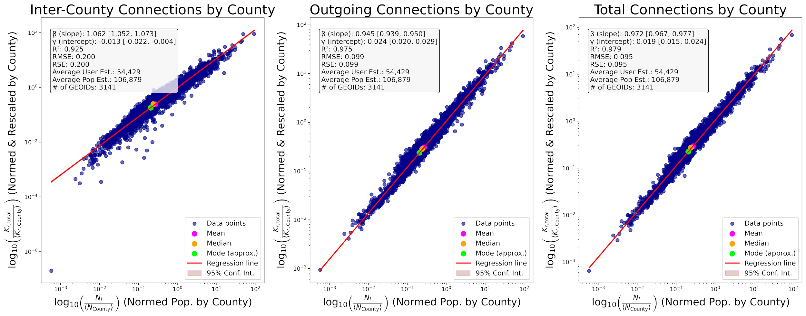

Slide 8
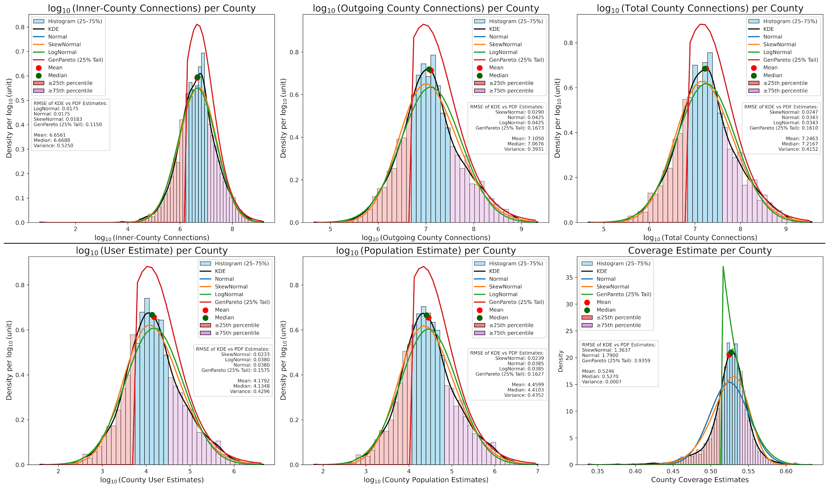

Slide 9
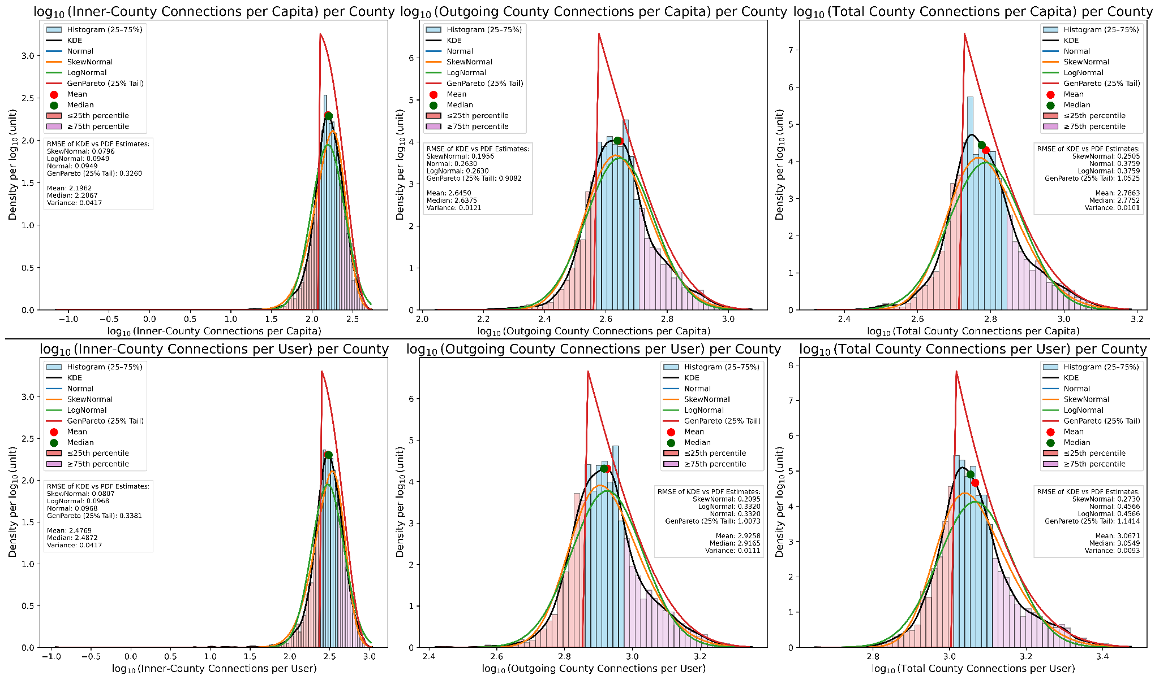

Slide 10
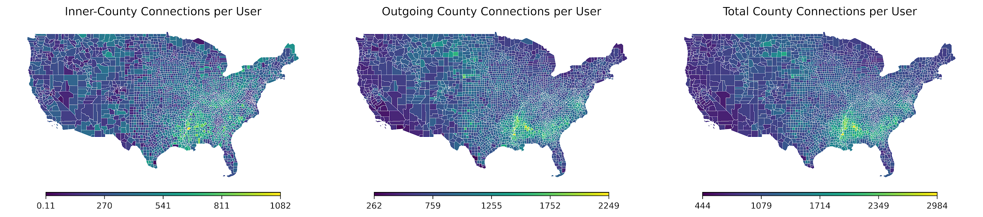
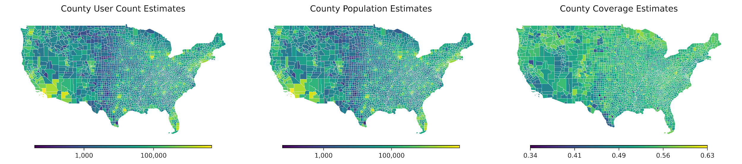

Slide 11
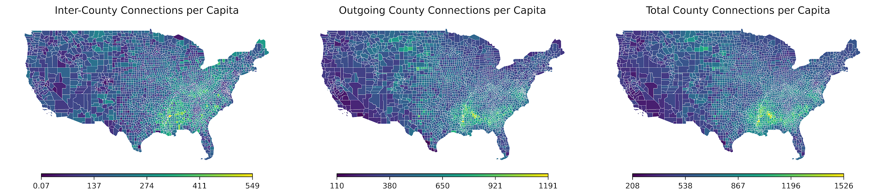

Slide 12
CBSA
Plots
Regressions
Histograms

Slide 13
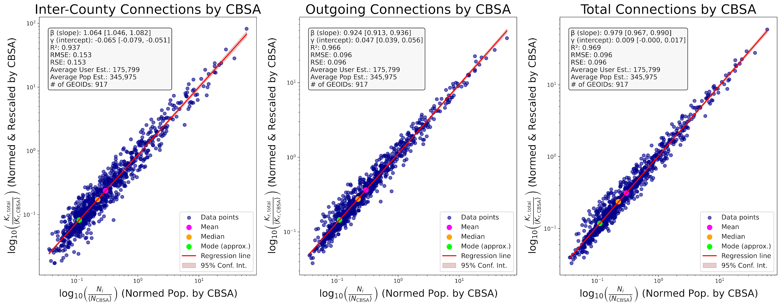

Slide 14
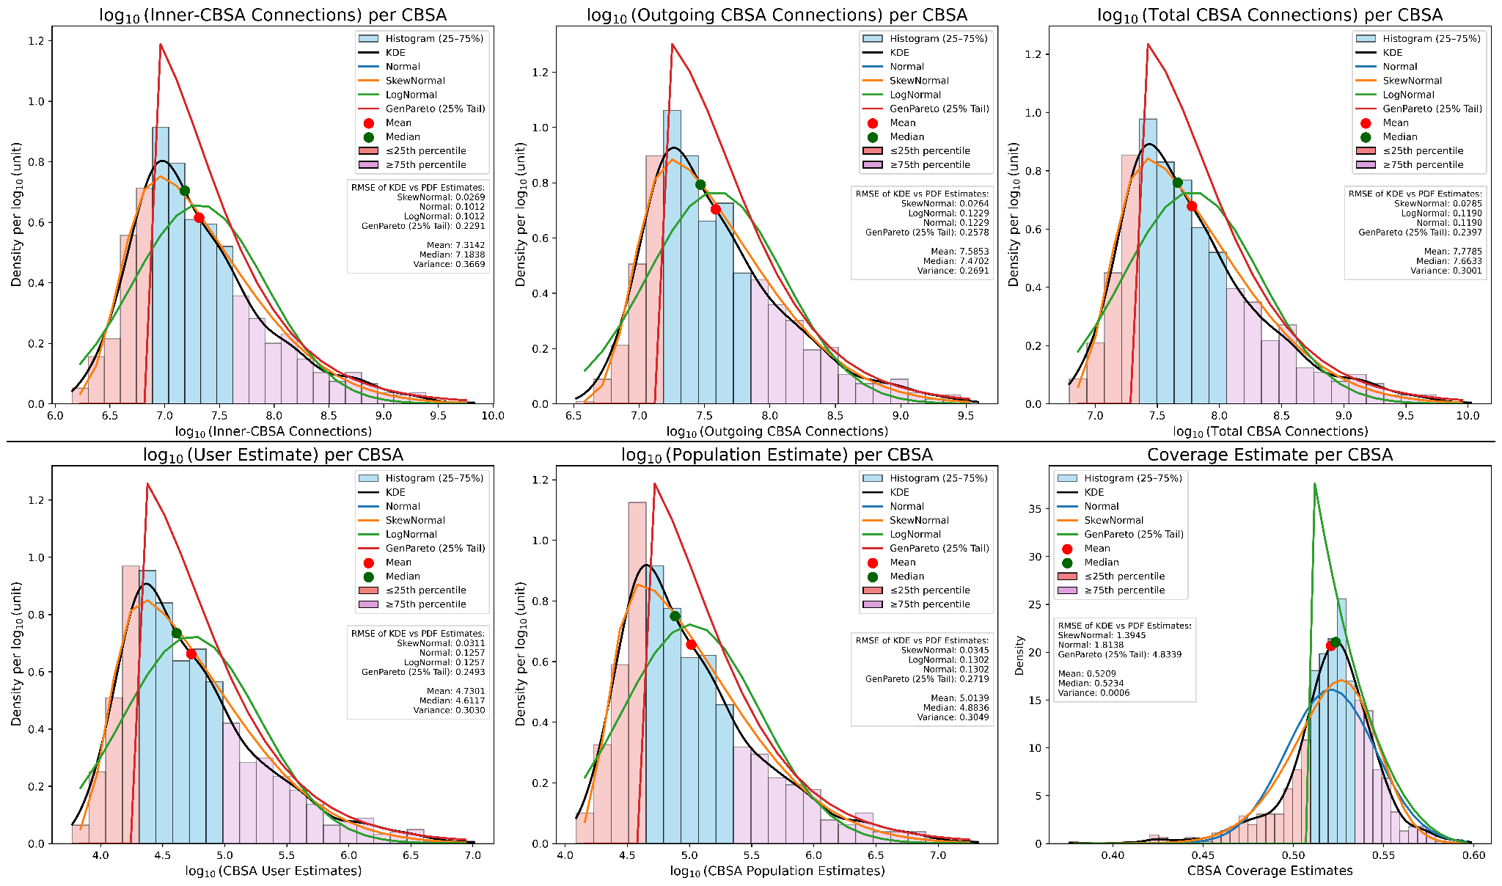

Slide 15
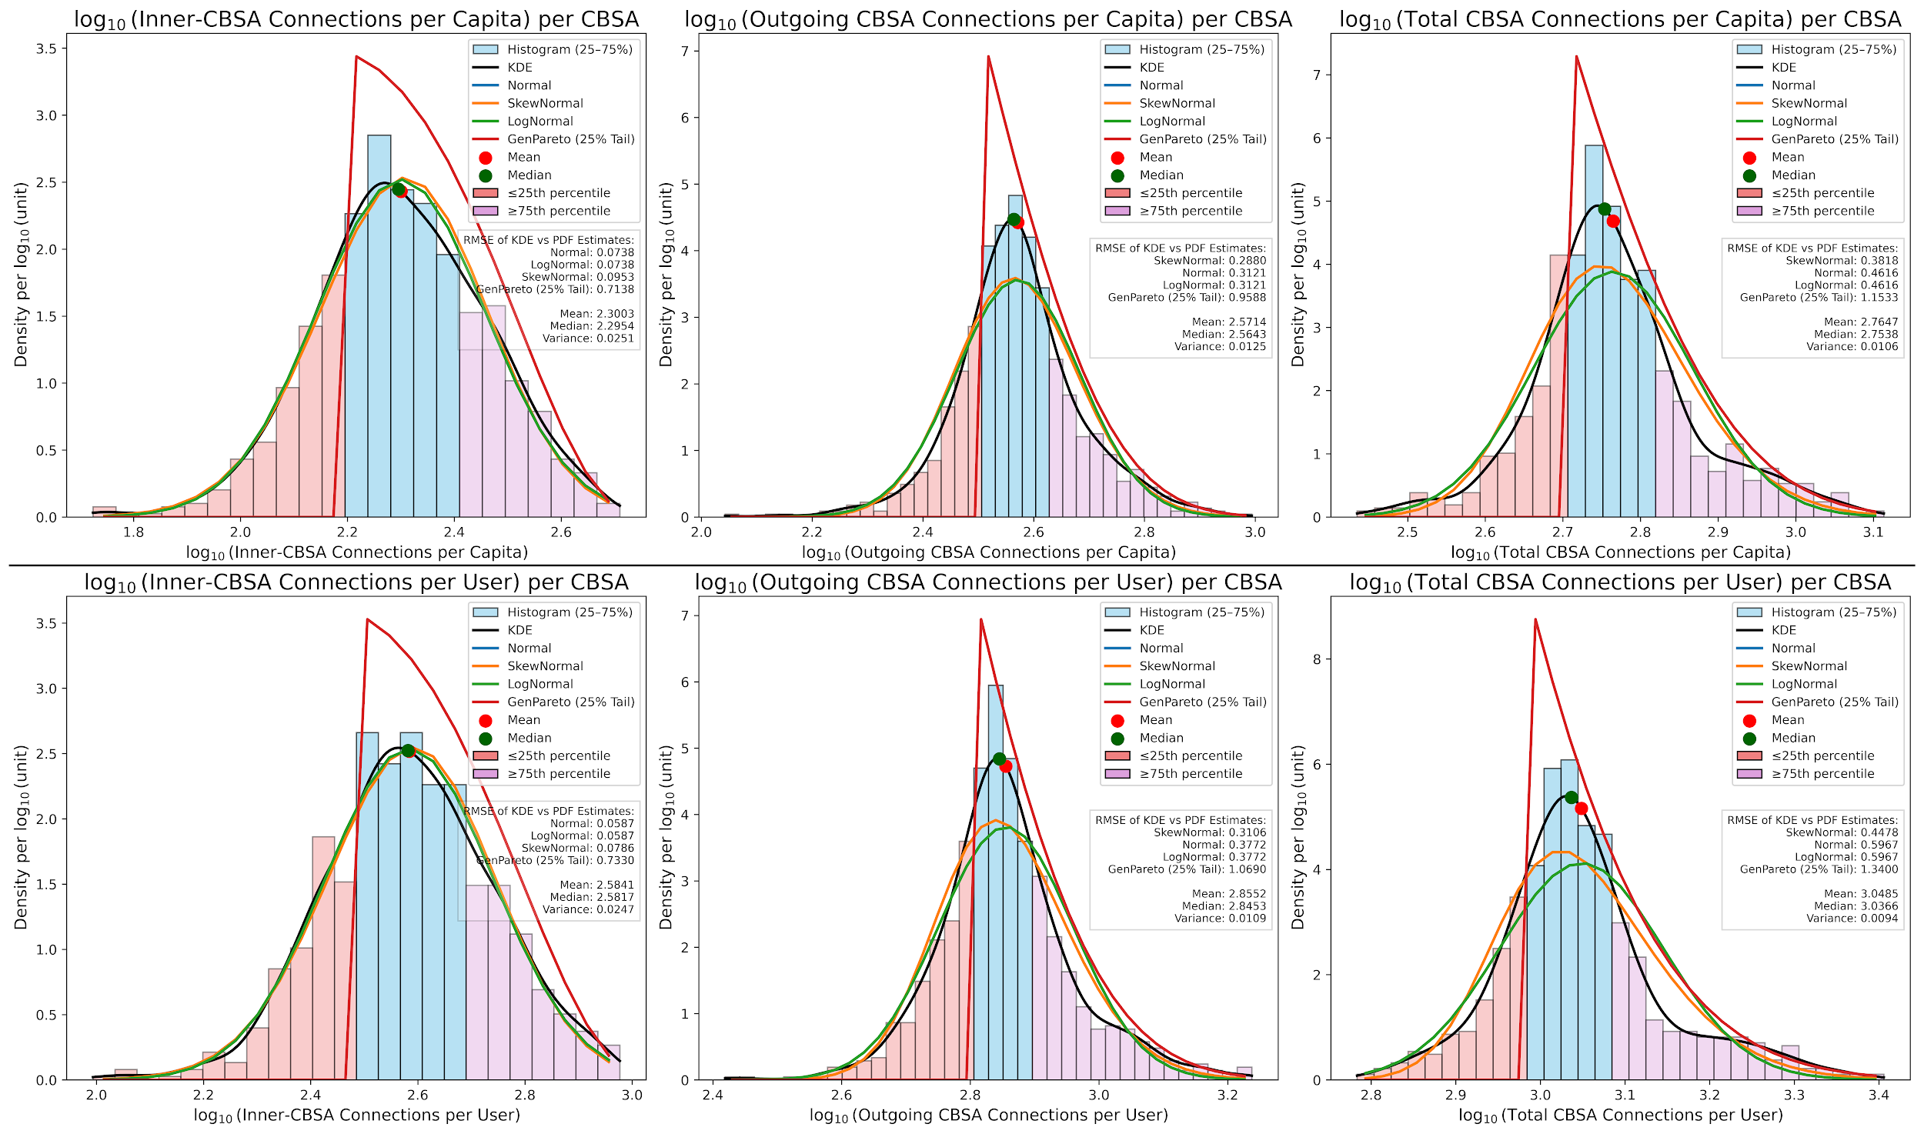

Slide 16
MSA
Plots
Regressions
Histograms

Slide 17
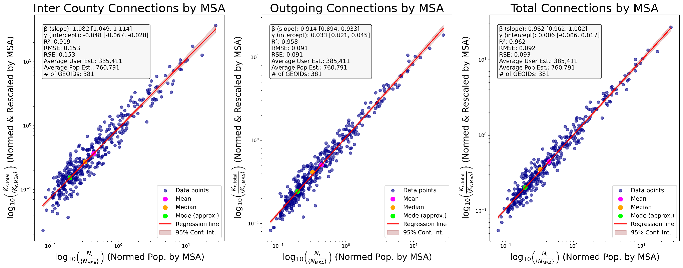

Slide 18
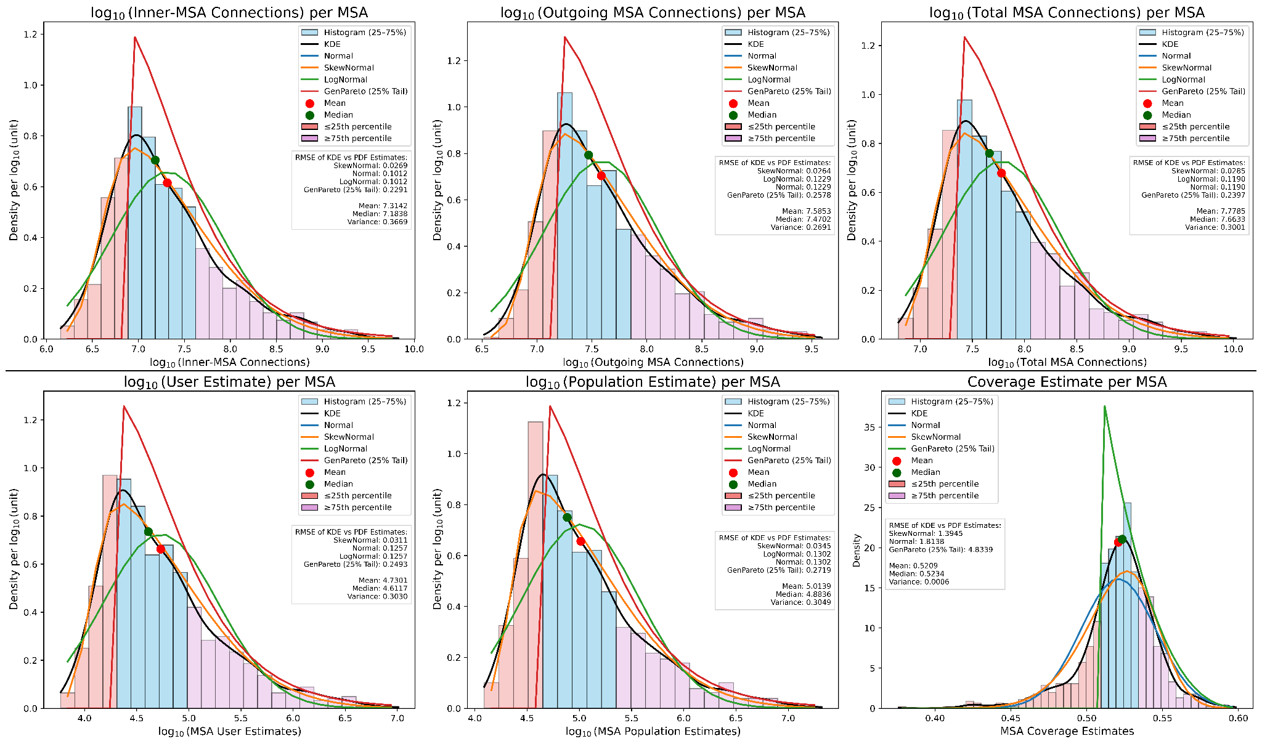

Slide 19
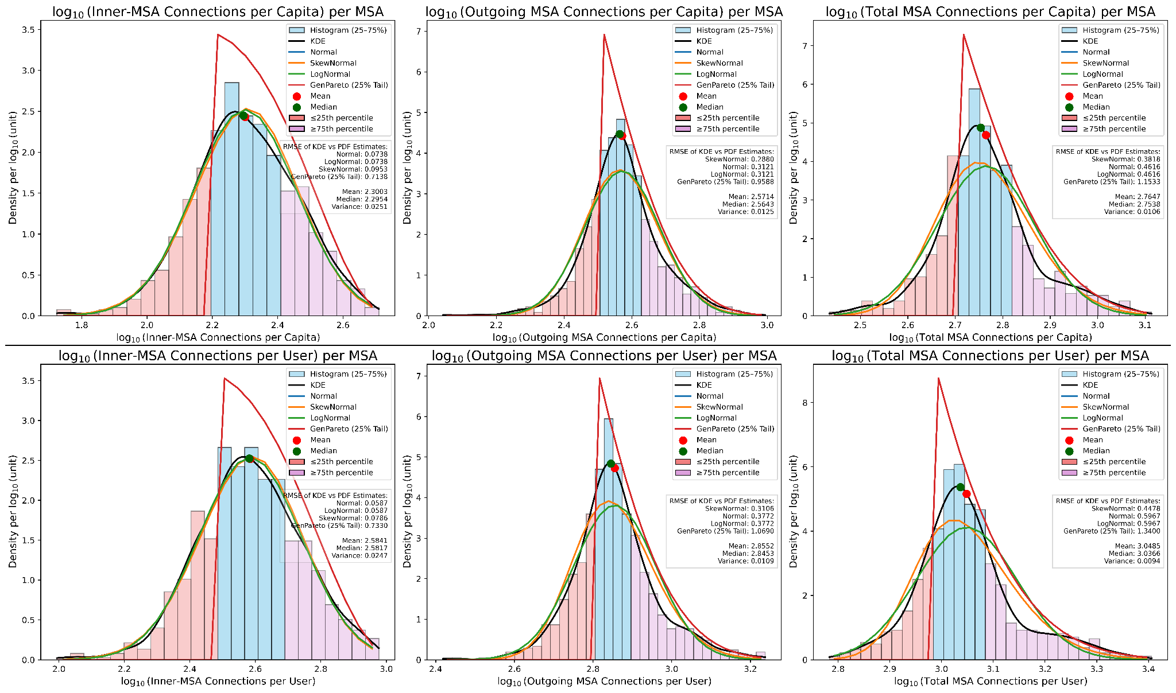

Slide 20
muSA
Plots
Regressions
Histograms

Slide 21
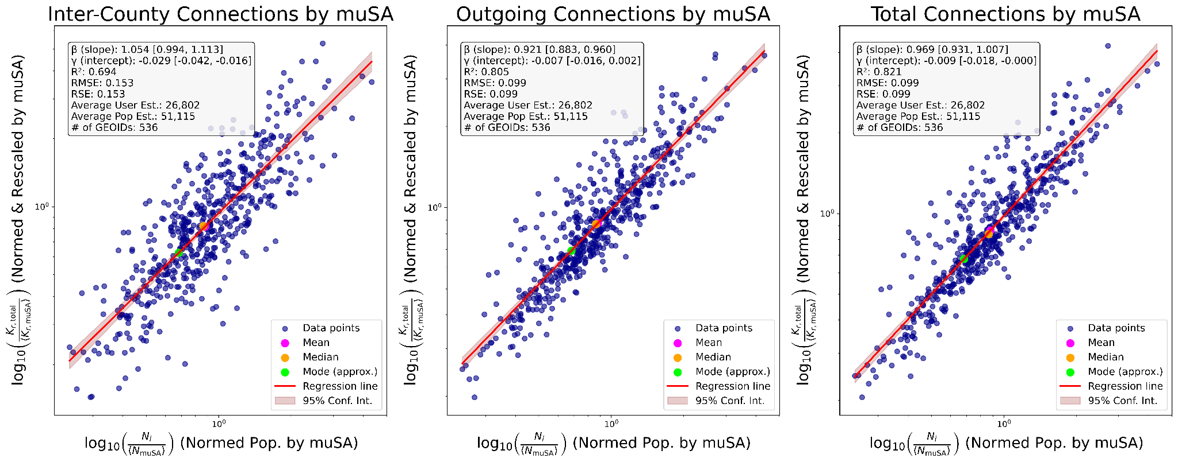

Slide 22


Slide 23


Slide 24
Hamilton Beach
Demographic Plots
Pi Charts
Bar Charts
All selected blocks

Slide 25
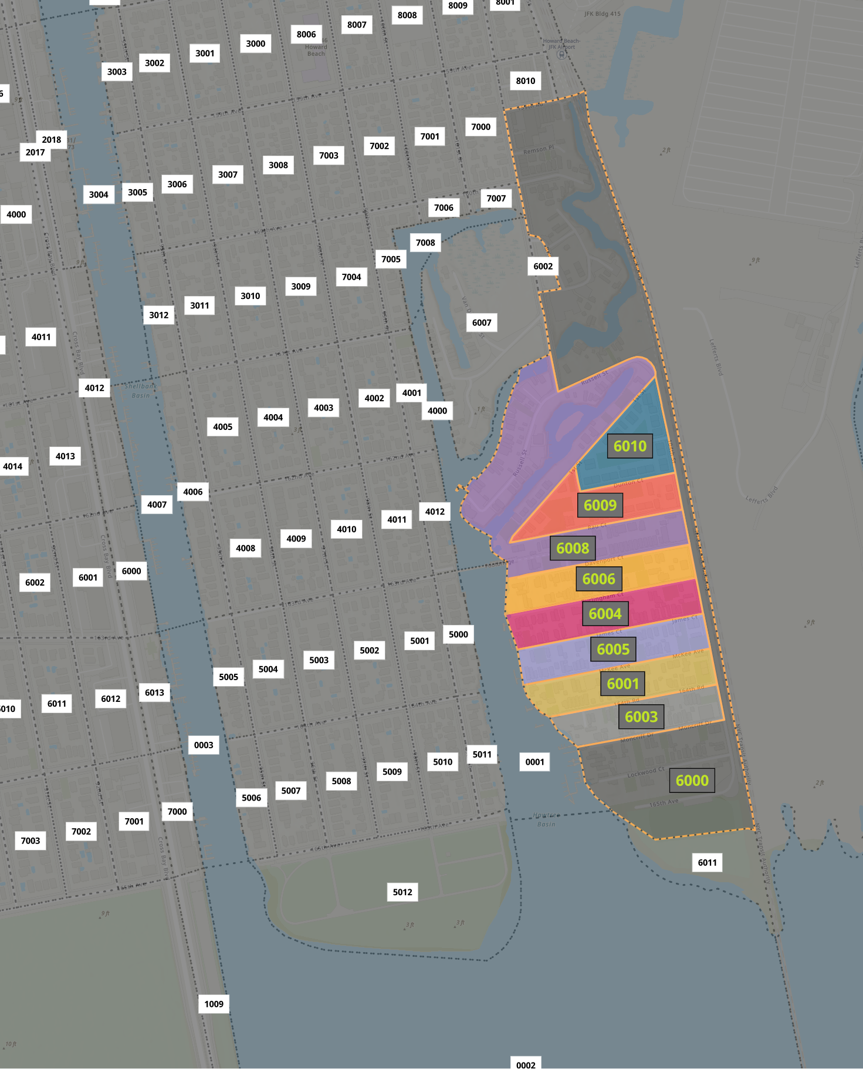
HB Census Blocks:
Single Family Homes:

Slide 26
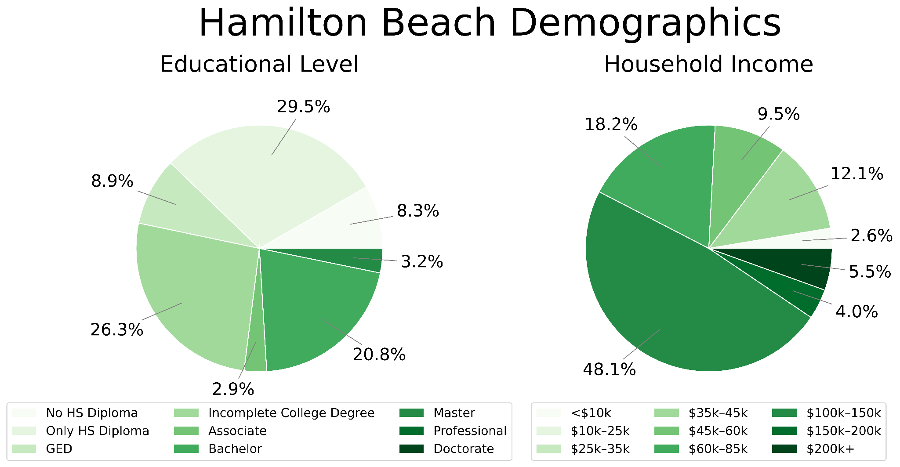

Slide 27
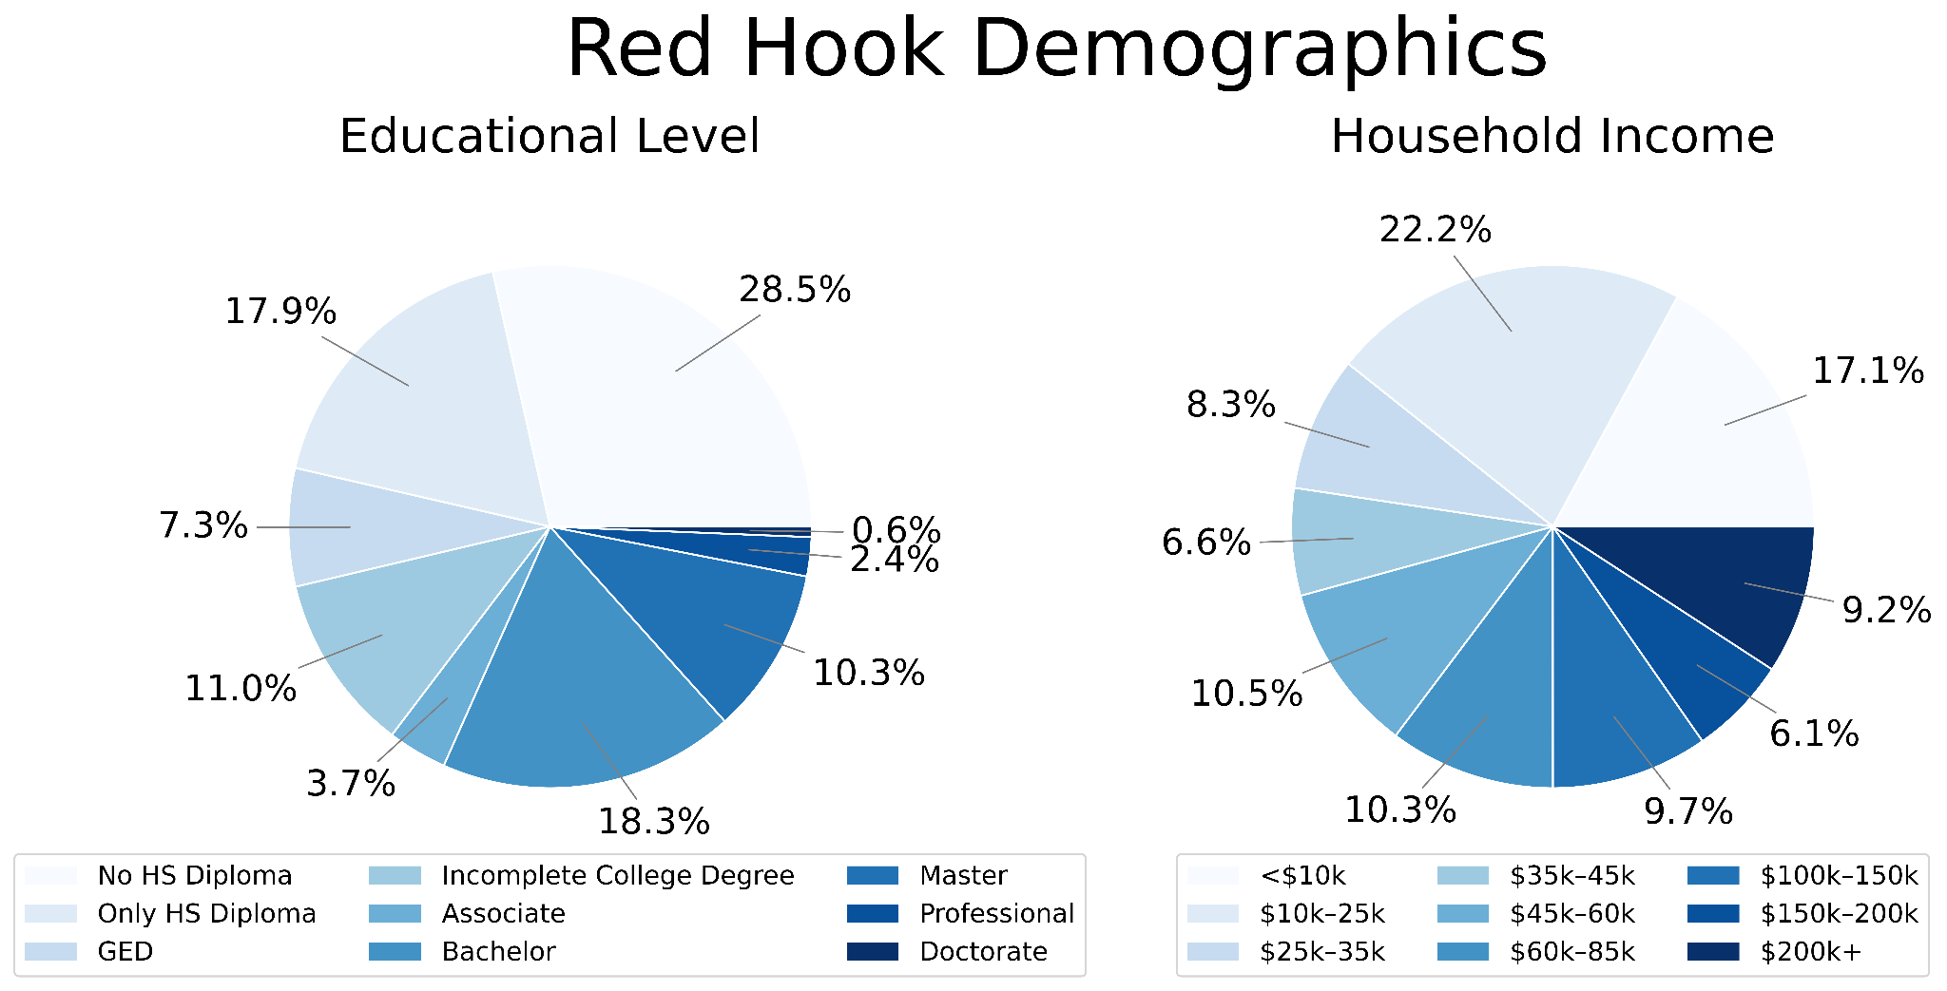

Slide 28
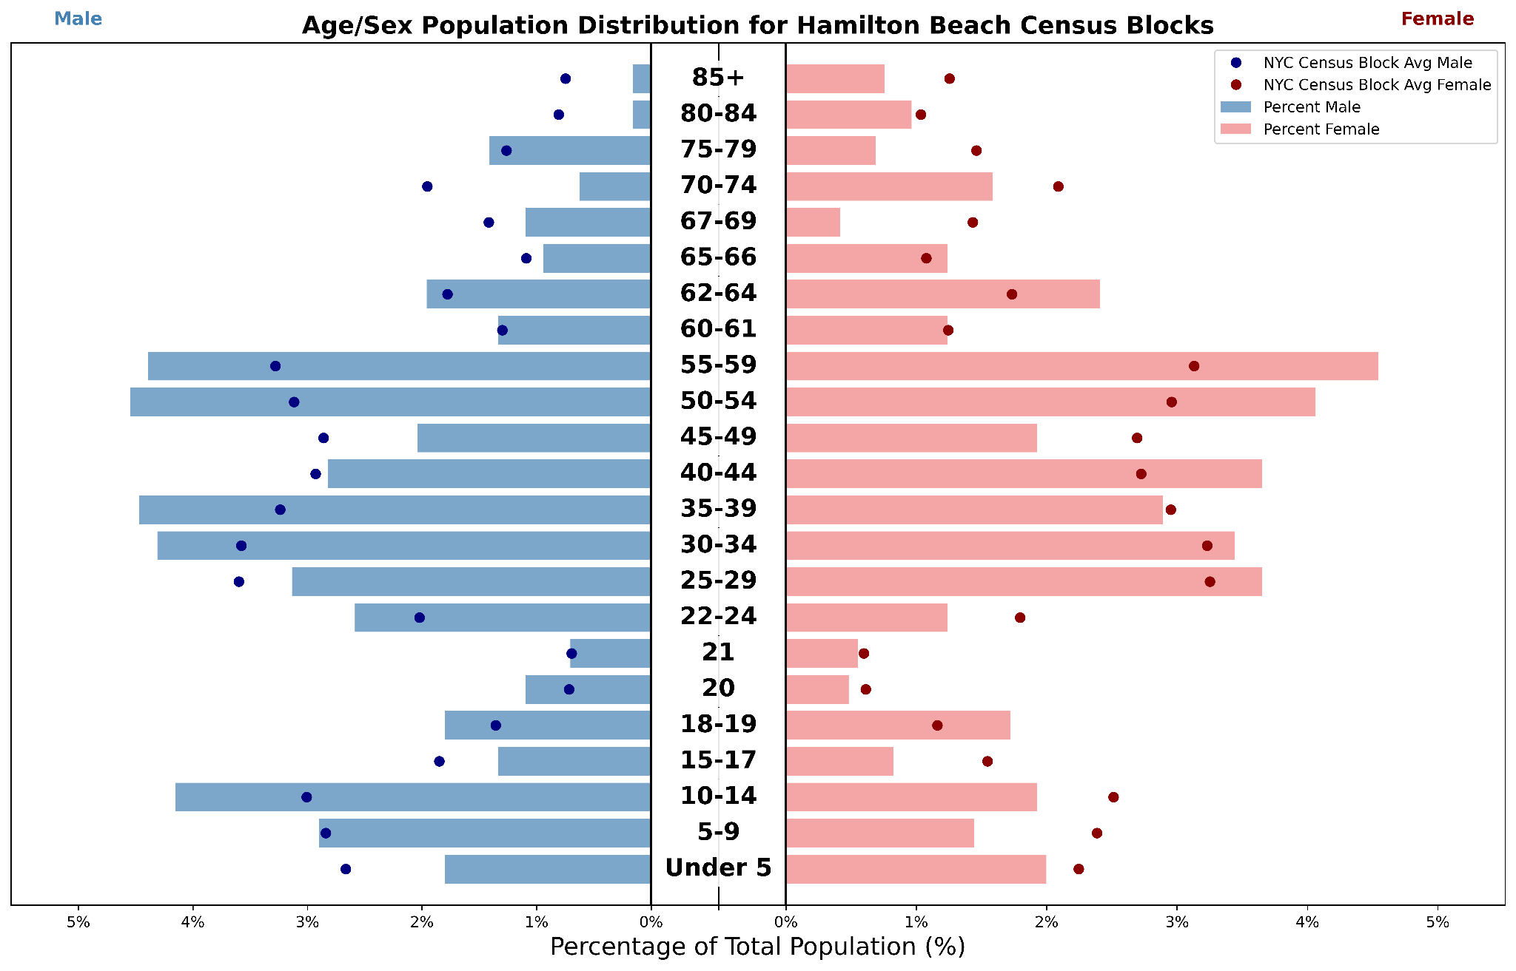

Slide 29
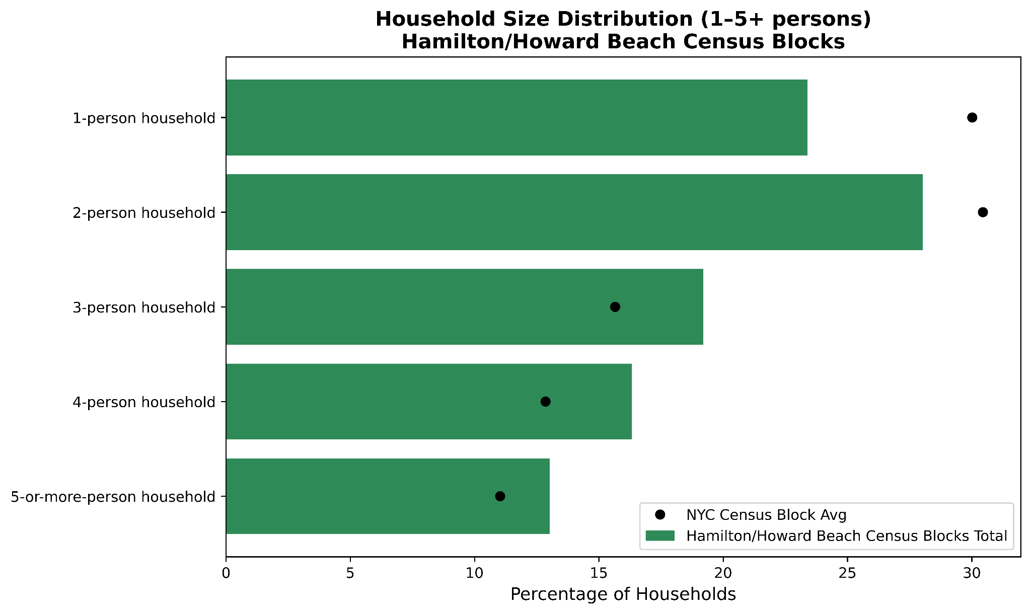

Slide 30
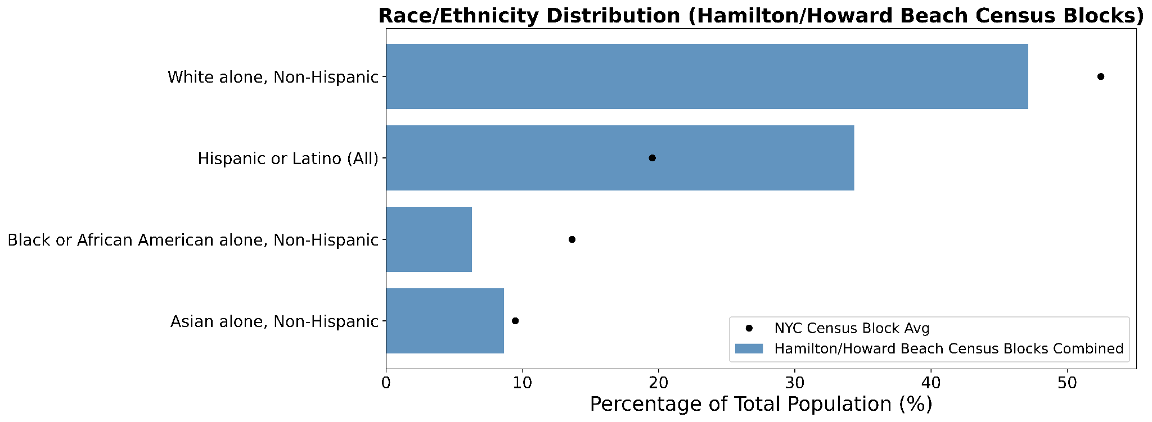

Slide 31
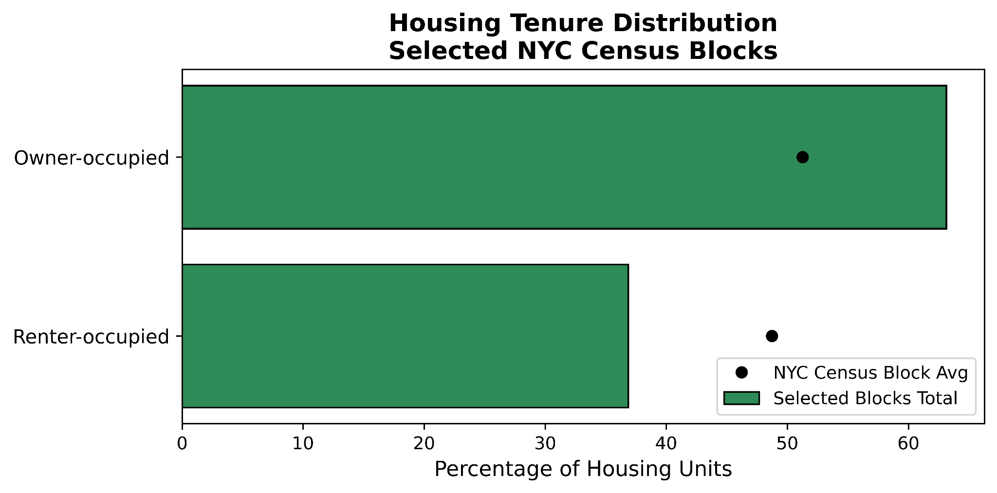

Slide 32
